Slide 1
Secure custom APIs with Microsoft Identity
Notes:
Many solutions involve creating web APIs to expose functionality to different clients and consumers. Developers can secure these APIs using Microsoft identity to ensure only approved apps can access the web APIs provided they've been granted the necessary permissions.

Slide 2

Overview
On-behalf-of flow
Create Microsoft-identity secured web apps
Configure web apps to call secured web APIs
Notes:
In this unit, you’ll learn how to create server-side web apps that enable users to sign in and grant the app permissions to act on the user’s behalf.

Slide 3
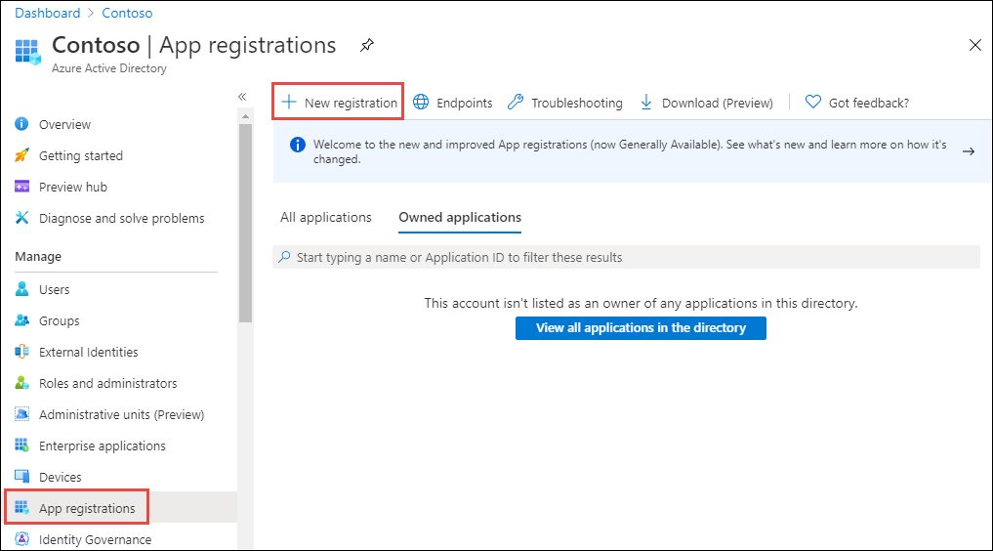
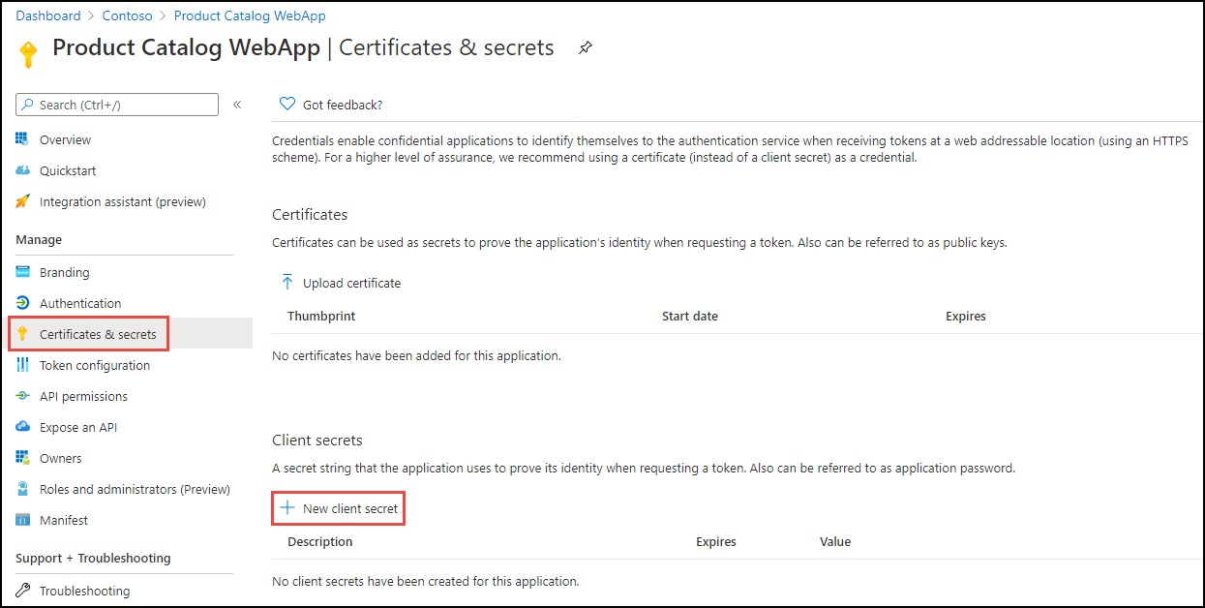
Create Microsoft identity-secured web apps
Register a new Azure AD app
Configure the app with an app secret
NOTE:
Use certificates instead of app secrets in production environments
Notes:
Now let's see how to create and configure a web API so that it can access a secured web API on behalf of a signed in user.
The first step is to register a new Azure AD app in the Azure AD admin center that will represent the web application.
The important part of the app registration is the creation of an app secret. This secret, along with the client ID of the app, are used by the web application to authenticate with Microsoft identity when it requests an access token on behalf of the signed in user.
Web apps that call web APIs are *confidential client* applications. That's why they register a secret (an application password or certificate) with Azure AD.

Slide 4
Configure web applications to call secured APIs
Create .NET Core project
Use the --auth [SingleOrg|MultiOrg] option when creating the project
Includes auth scaffolding classes and code to simplify project configuration
Add Microsoft identity packages to include MSAL.NET & Microsoft.Identity.Web in the project:
dotnet new mvc --auth [SingleOrg|MultiOrg]
dotnet add package Microsoft.Identity.Web dotnet add package Microsoft.Identity.Web.UI
Update the project’s appsettings.json file to include the domain, tenant ID, client ID and client secret of the registered Azure AD app associated with the web app
Notes:
The next step is to create the web application that will allow the user to sign in and then access the secured web API.
Create a new ASP.NET Core MVC application using the following command, followed by installing a few NuGet packages to support and Microsoft identity.
Now update the project to associate it with the Azure AD app you registered for the web app. Open the **appsettings.json** file and set the details of the registered Azure AD application you previously created. This includes details such as:
- **Domain**: the domain of your Azure AD tenant where you registered the Azure AD application
- **TenantId**: the ID of your Azure AD tenant where you registered the Azure AD application
- **ClientId**: the ID of your Azure AD application
- **ClientSecret**: the secret of your Azure AD application

Slide 5
Create, configure and load an instance of a confidential client
public void ConfigureServices(IServiceCollection services)
{
services.AddAuthentication(OpenIdConnectDefaults.AuthenticationScheme)
.AddMicrosoftIdentityWebApp(Configuration.GetSection("AzureAd"))
.EnableTokenAcquisitionToCallDownstreamApi(Constants.ProductCatalogAPI.SCOPES)
.AddInMemoryTokenCaches();
services.AddControllersWithViews(options =>
{
var policy = new AuthorizationPolicyBuilder().RequireAuthenticatedUser().Build();
options.Filters.Add(new AuthorizeFilter(policy));
});
services.AddRazorPages()
.AddMicrosoftIdentityUI();
}
Notes:
Next, configure the web app's authentication by updating the `ConfigureServices()` method in the `Startup` class for the project. This code will configure the web app's middleware to support Azure AD for authentication and to obtain an ID token:

Slide 6
Securing controllers
services.AddControllersWithViews(options =>
{
var policy = new AuthorizationPolicyBuilder()
.RequireAuthenticatedUser()
.Build();
options.Filters.Add(new AuthorizeFilter(policy));
}).AddMicrosoftIdentityUI();
services.AddRazorPages();
Notes:
The next step is to configure the web app’s controllers and views to use the authentication configuration you just setup.

Slide 7
Adding permissions to controller endpoints
[AuthorizeForScopes(Scopes = new[] { Constants.ProductCatalogAPI.ProductReadScope })]
public async Task<ActionResult> Index() {
var client = new HttpClient();
var accessToken = await
tokenAcquisition.GetAccessTokenForUserAsync(Constants.ProductCatalogAPI.SCOPES);
client.DefaultRequestHeaders.Authorization = new
AuthenticationHeaderValue("Bearer", accessToken);
string json = await client.GetStringAsync(Constants.ProductCatalogAPI.ProductUrl);
var serializerOptions = new JsonSerializerOptions{
PropertyNamingPolicy = JsonNamingPolicy.CamelCase
};
var products = JsonSerializer.Deserialize(json,
typeof(List<Product>), serializerOptions) as List<Product>;
return View(products);
}
Notes:
The last step is to update your controllers to use the custom scopes defined by the API.

Slide 8
Demo

Slide 9
Thank you.

